Slide 1
Which is true?
Hand-written patterns are in general more precise than classifiers
Hand-written patterns cannot exploit syntactic features
Supervised classifiers do not require any human input
Supervised classifiers can only detect typed statements
Notes:
Answer A
Answer B is exactly the opposite of what is the case, that patterns exploit syntactice features. Classifiers requires human input for labelling. They also can be used to detet untyped statements.

Slide 2
Which is true?
Distant supervision requires rules for bootstrapping
Classifiers produced with distant supervision are more precise than rules
Distant supervision can help to detect rules
Notes:
Answer C
Distant supervision does not require and rules, as opposed to bootstrapping. Classifiers from distant supervision tend to be less precise than hand-written rules, though in some cases they achieve comparable performance. Using complex features, distant supervision effectively detects new rules.

Slide 3
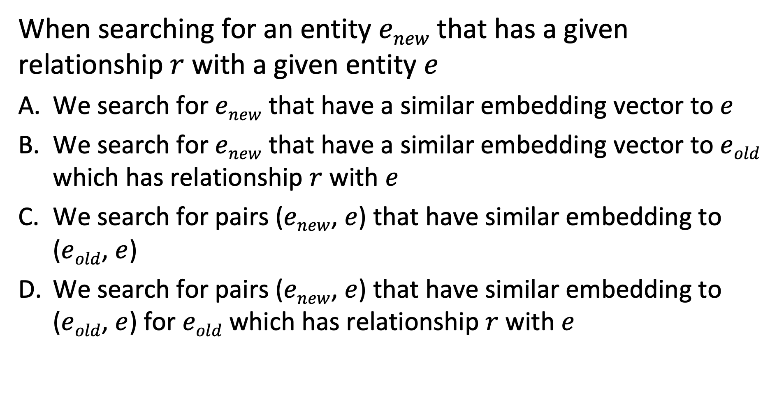
Question
When searching for an entity $enew$ that has a given relationship $r$ with a given entity $e$
We search for $enew$ that have a similar embedding vector to $e$
We search for $enew$ that have a similar embedding vector to $eold$ which has relationship $r$ with $e$
We search for pairs ($enew$, $e$) that have similar embedding to ($eold$, $e$)
We search for pairs ($enew$, $e$) that have similar embedding to ($eold$, $e$) for $eold$ which has relationship $r$ with $e$
Notes:
Answer C
In the model for relation embedding individual entities have no embedding, therefore Answers A and B are not applicable. As for Answer D, it is not required that the existing embedding pairs ($eold$, $e$) have a confirmed relationship. However, we could also search for embeddings of relations r that are similar to the embedding ($enew$, $e$).

Slide 4
If t has no Hypernym ..
It is a root concept
It cannot match c such as t and X
It is identical to the initial root concept
It is a basic concept
Notes:
Answer A
Hypernym means that the concept has no more general concept, therefore it is a root concept. It cannot be part of the pattern from Answer B, since c would be a hypernym of t. In the search for hypernyms different root concepts can be found that have no relation among each other, which excludes Answer C.

